Slide 1
Project :- Email Application
Presented By,
Ms Unnati R. Kambale

Slide 2
Contends
Introduction
ER Diagram
Use Case Diagram
Modules
Software & Database
Advantages
Application
Output
Future Scope

Slide 3
Introduction
Simple Email Application is a Java project that is designed for sending & receiving the emails. This project made in Eclipse IDE and using the Database. Here you can simply add the compose and inbox methods. Compose is used sending the messages like documents, files or any other data and inbox are used display all the email .
Here is the list of many peoples they register the mail id, and in there database stored the information peoples in table format. When you search the list of peoples they show the result in their console and MYSQL also.
The Java console class is be used to get input from console. It provides methods to read texts and passwords. Console is attached with system console internally.

Slide 4
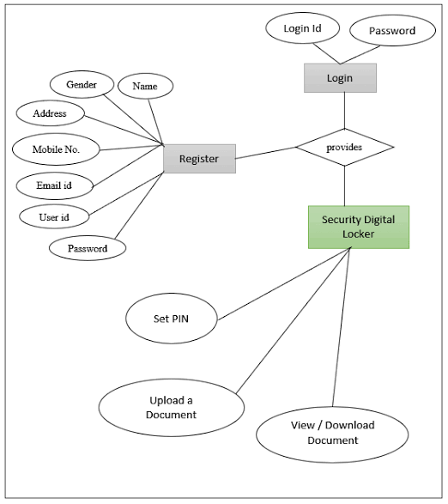
ER diagram

Slide 5
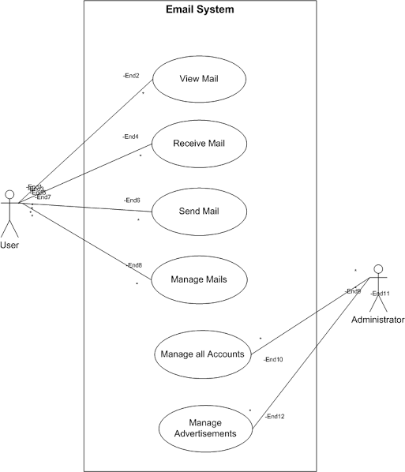
Use case Diagram

Slide 6
Software & Database
Eclipse is an integrated development environment(IDE) used in computer programming. It contains a base workspace and an extensible plug-in system for customizing the environment. Eclipse is written mostly in Java and its primary use is for developing Java applications, but it may also be used to develop application in other programming languages via plug-ins, including JavaScript C, C++,C#, PHP.
We used Eclipse IDE for developed This project.

Slide 7
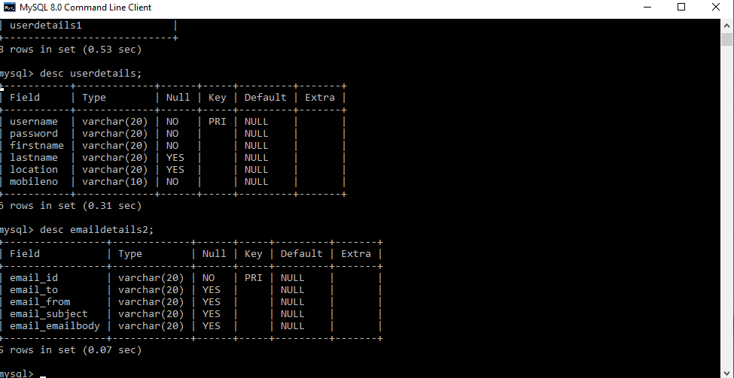
In our project use MYSQL server 8.0 including
No SQL document store, atomic and crash safe
DDL sentences and JSON Extended Syntax,
new function, such as JSON table function, improved sorting, and partial MYSQL is an open source relational database management system (RDBMS). Its name is a updates. Combination of “MY” , the name of co- founder Michael Widenius’s daughter, and “SQL” , the abbreviation for structured Query Language. A relational database organizes data into one or more data tables in which data types may be related to each other, these relations help structure the data. SQL is a language programmers use to create , modify and extract data from the relational database, as well as control user access to the database . In addition to relational databases and SQL, an RDBMS like MYSQL works with an operating system to implements to a relational database in a computer’s storage System , manages users, allows for network access and facilitates testing database integrity and creation of backups.

Slide 8
Advantages
Email is a Simple.
Email is a free tool.
Email allows for easy referencing.
Email is accessible from anywhere – as long as you have an internet connection.

Slide 9
Application
Email- a computerized system for sending digital messages from one computer to one more other computers.
Purpose- flexibility of email allows it to be used for friendly letters or for some business situations.

Slide 10
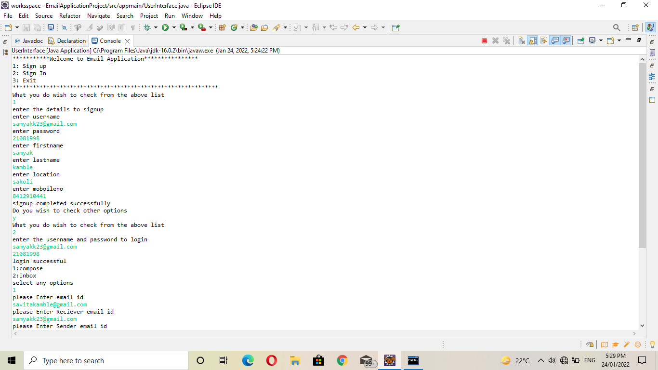
Output
Console result-

Slide 11
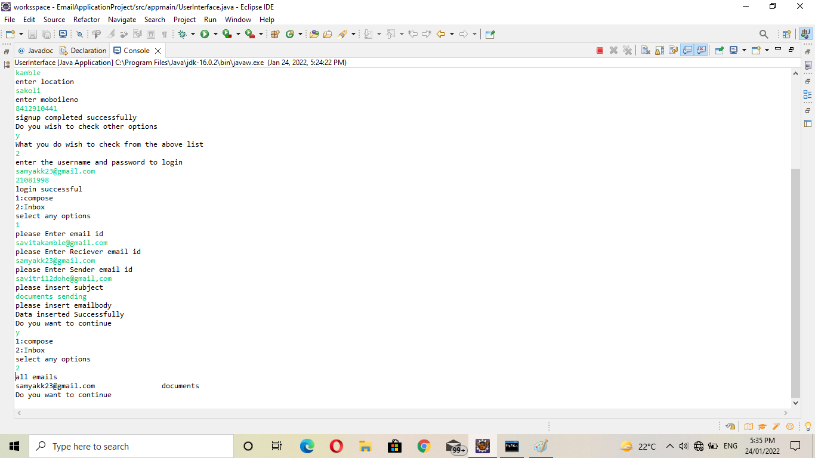

Slide 12
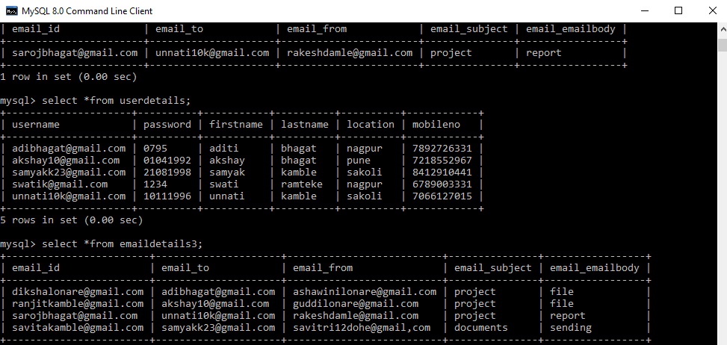
tables

Slide 13
Thank You !

